Slide 1

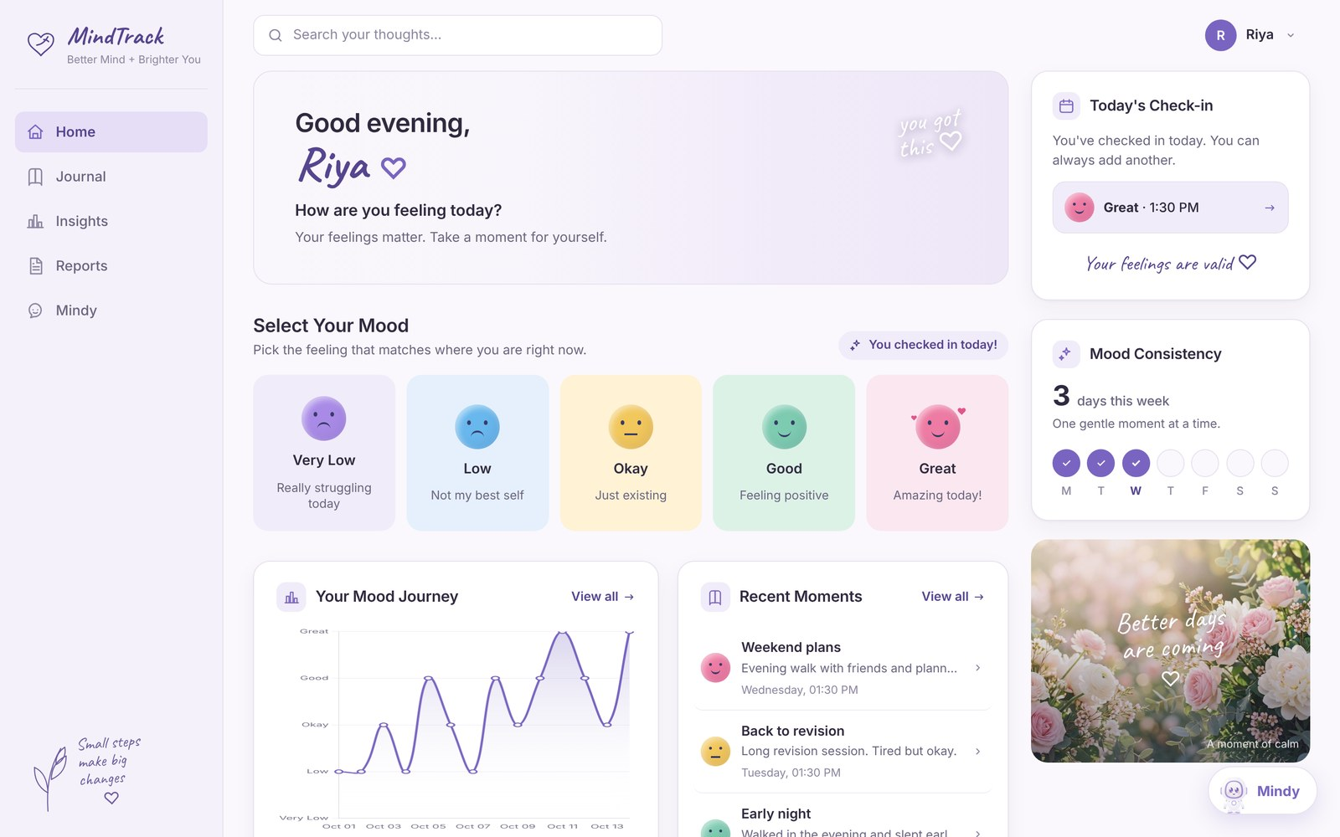

COLLEGE MINI PROJECT
MindTrack
A Privacy-First Mood Journaling &
Self-Reflection Web App
Your thoughts deserve a place to land.
TEAM
[Member 1 Name – Roll No.]
[Member 2 Name – Roll No.]
[Member 3 Name – Roll No.]
[Member 4 Name – Roll No.]
Real app screenshot · demo account “Riya”
Guided by [Guide Name, Designation]
[Department], [College Name] · [Month Year]
Notes:
Good morning. We are presenting MindTrack, a privacy-first mood journaling and self-reflection web app. On the right is the real app running with a demo account, Riya. Our idea: small daily check-ins that add up to a clear picture of how you feel and why, without ever making anyone feel diagnosed.

Slide 2





Problem Statement & Objectives
02 / 09 WHY MINDTRACK
1 in 7
What we set out to do
10–19-year-olds worldwide experience a mental disorder
…and how typical single-purpose apps compare ✓ yes ~ partly – no
OBJECTIVE | Mood app | Journal app | Chatbot | MindTrack
Make daily mood check-ins quick and comforting. | ✓ | – | – | ✓
Turn a user's own entries into understandable, non-diagnostic patterns. | ~ | – | – | ✓
Encourage reflection with gentle CBT-inspired prompts. | – | ~ | ~ | ✓
Protect journal text with encryption. | – | ~ | – | ✓
Let users export a counselor-friendly PDF, on their terms. | – | – | – | ✓
Source: WHO, Mental health of adolescents, 2025
THE PROBLEM
Students and young adults rarely track how they feel or why.
Most apps do only one thing: mood logs, journaling, or a chatbot.
Generic insights feel like black boxes, or worse, like diagnoses.
Private thoughts deserve real privacy protection.
Notes:
According to the WHO, one in seven 10-19 year olds worldwide experiences a mental disorder, yet most students never track how they feel or why. Existing apps tend to do just one thing: log moods, hold a journal, or chat. On the right are our five objectives, and the table shows how typical single-purpose apps cover them compared with MindTrack.

Slide 3







Key Features
03 / 09 WHAT IT DOES
Follow Riya, our demo user, through one exam week →
+ Mindy, a friendly companion chatbot
STEP 1
STEP 2
STEP 3
STEP 4
STEP 5
Check in
Journal
Insights
Reflect
Report
Daily mood check-in (5 moods) + optional note and context tags
Private journal: create, edit, delete, history
Mood chart, top contexts, Mood × Context, evidence-based observations
Reflection prompts with private answers
PDF reflection report (journal text only if the user opts in)
RIYA
RIYA
RIYA
RIYA
RIYA
Day 1: logs “Low” and tags Study as exam week starts.
Writes about late nights and two deadlines on one day.
Sees a good mood in 5 of her 6 Health & wellbeing entries.
Realises the evening walks are what helped most.
Shares a PDF with her counsellor, journal text left out.
Notes:
Let's follow Riya, our demo user, through one exam week. She checks in with a mood and a context tag, writes in her private journal, and after a few days the Insights page notices a pattern from her own entries. Prompts help her reflect, and she can export a PDF for a counsellor, leaving her journal text out if she wants. Mindy, our companion chatbot, is available all along.

Slide 4







Technology Stack
04 / 09 HOW IT'S BUILT
LAYER | TECHNOLOGIES
Backend | Python, Flask (Jinja2 templates), Flask-SQLAlchemy
Database | SQLite (local); PostgreSQL ready for production
Security | Werkzeug password hashing, Flask-WTF CSRF, Fernet encryption (cryptography)
Analysis | TextBlob sentiment, keyword-based theme detection
Visuals & reports | Chart.js, ReportLab (PDF)
Frontend | HTML, CSS, vanilla JavaScript
Testing & deployment | pytest, Docker, Gunicorn, Cloud Run + Firebase Hosting (prepared)
Notes:
This is our technology stack, layer by layer. Flask with Jinja2 templates on the backend, SQLAlchemy over SQLite locally and PostgreSQL in production. Security relies on Werkzeug password hashing, Flask-WTF CSRF protection and Fernet encryption. TextBlob handles sentiment, Chart.js and ReportLab handle charts and PDFs, and the project is tested with pytest and packaged with Docker and Gunicorn.

Slide 5





System Architecture
05 / 09 HOW IT FITS TOGETHER
Browser
Flask routes (blueprints)
Service layer
SQLAlchemy models
Database
CLIENT
BLUEPRINTS
SERVICES
DATA ACCESS
STORAGE
HTML, CSS, vanilla JS
Jinja2-rendered pages
Chart.js charts
auth
dashboard
journal
insights
reports
mindy
encryption
sentiment
themes
insights
reflection
reports
Mindy
Flask-SQLAlchemy ORM
Queries scoped to the logged-in user
Encrypted text fields
SQLite (local)
PostgreSQL ready for production
Notes:
Requests flow left to right: the browser calls Flask routes organised into six blueprints, the routes call a service layer, which contains all the logic, and services use SQLAlchemy models to read and write the database. Keeping logic in services made the app easy to test.

Slide 6






Privacy & Security
06 / 09 TRUST BY DESIGN
WHAT RIYA WROTE
WHAT THE DATABASE ACTUALLY STORES
“Paper went okay. Took a long walk in the evening and felt lighter.”
gAAAAABqz9oDWKw-P7fKVtrawbv1gm7HQ2fYSk9YKjxfrqbkyqYoEkIP…
Fernet
Open the database and journal text is just scrambled characters. Only the app, with its secret key, can read it.
Passwords stored only as secure hashes
Journal text, reflections and chats encrypted with Fernet
Every query scoped to the logged-in user; no cross-user access
CSRF protection on every form; secure, HTTP-only session cookies
Secret keys kept outside the code (.env / Secret Manager)
Notes:
Here is a real entry from our demo account and what is actually stored in the database: Fernet ciphertext. Without the app's secret key, journal text is unreadable. On top of that, passwords are hashed, every query is scoped to the logged-in user, every form has CSRF protection, and secrets live outside the code.

Slide 7
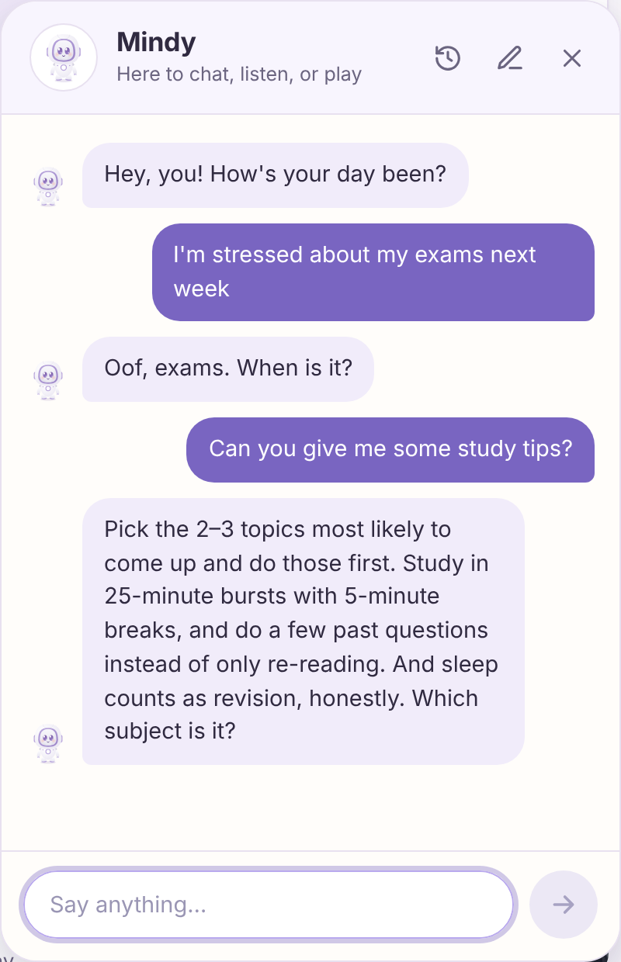
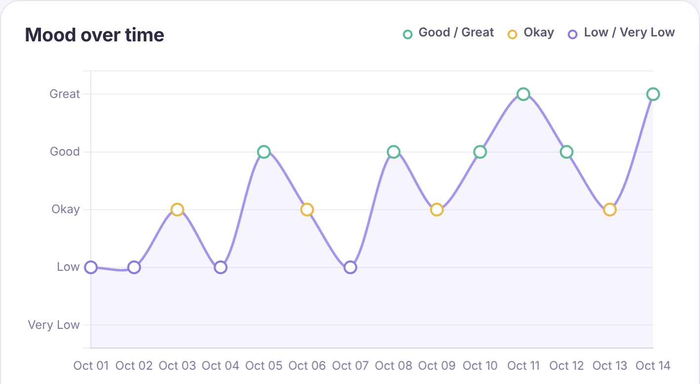


Insights & Mindy
07 / 09 GENTLE, PERSONAL SUPPORT
Insights from the user's own data
Mindy
7/30-day/all-time views · mood trends · context breakdown
Rule-based companion (no external AI)
Understands 30+ everyday topics
Listens, gives practical tips when asked, tells jokes, plays games
REAL SCREENSHOT · DEMO ACCOUNT
Safety: crisis messages get support resources immediately
“You recorded a good mood in 5 of your 6 Health & wellbeing entries.”
Cautious wording: “just something to notice, not a diagnosis”
Notes:
These are real screenshots from the demo account. The mood chart shows Riya's two weeks, and this observation was generated by the app from her own entries; note the careful wording, it's something to notice, not a diagnosis. On the right, Mindy answering a real message: she is rule-based, needs no external AI, and if a message sounds like a crisis she shares support resources immediately.

Slide 8




Testing, Limitations & Future Scope
08 / 09 WHERE WE ARE
TESTED
Limitations
Future scope
240
Mindy is rule-based
Search covers titles only (text is encrypted)
Not yet deployed
Account deletion & data export
Password reset
Cloud deployment
Optional AI-powered Mindy
automated tests (pytest)
All passing
Notes:
We wrote 240 automated tests with pytest, and all of them pass. We are honest about the limitations: Mindy is rule-based, search covers titles only because entry text is encrypted, and the app is not deployed yet. Next we want account deletion and data export, password reset, cloud deployment and optionally an AI-powered Mindy.

Slide 9







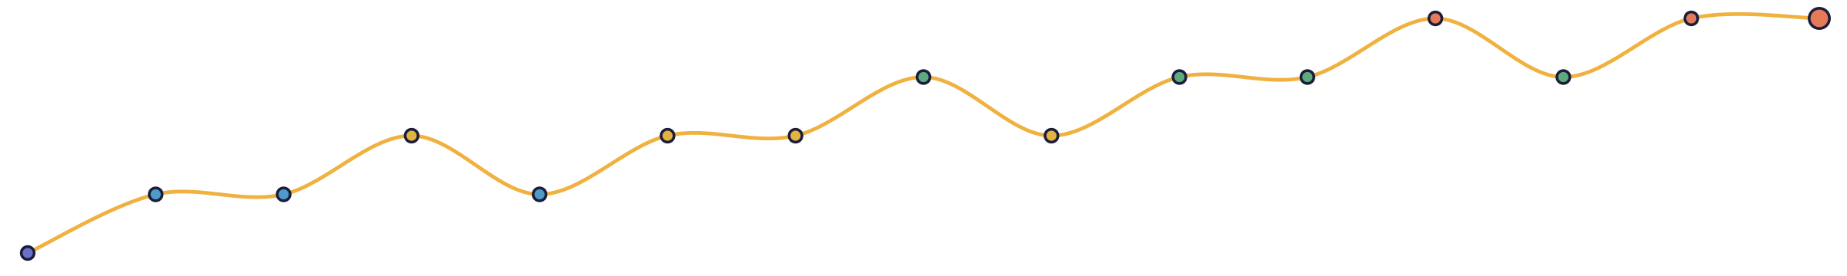
Thank You
LIVE DEMO
Watch MindTrack in action:
Questions?
Link
[App link]
Small steps make big changes.
QR code
[Member 1] · [Member 2] · [Member 3] · [Member 4]
Notes:
Thank you for listening. We'll now show a short live demo of MindTrack, and then we're happy to take your questions. (Before presenting: replace [App link] and the QR placeholder with your deployed link, or link a short screen recording.)

